Slide 1
WeatherBot
Akhil Nair R

Slide 2
Abstract
The purpose of the WeatherBot is to give weather based informations on environmental conditions such as temperature, humidity and light in a particular area or location. It is an AI and Machine Learning based bot developed using the Amazon Lex service.

Slide 3






AWS Services
Amazon Lex
Amazon Lambda
Amazon Cognito
Amazon Amplify
Amazon S3 Bucket

Slide 4
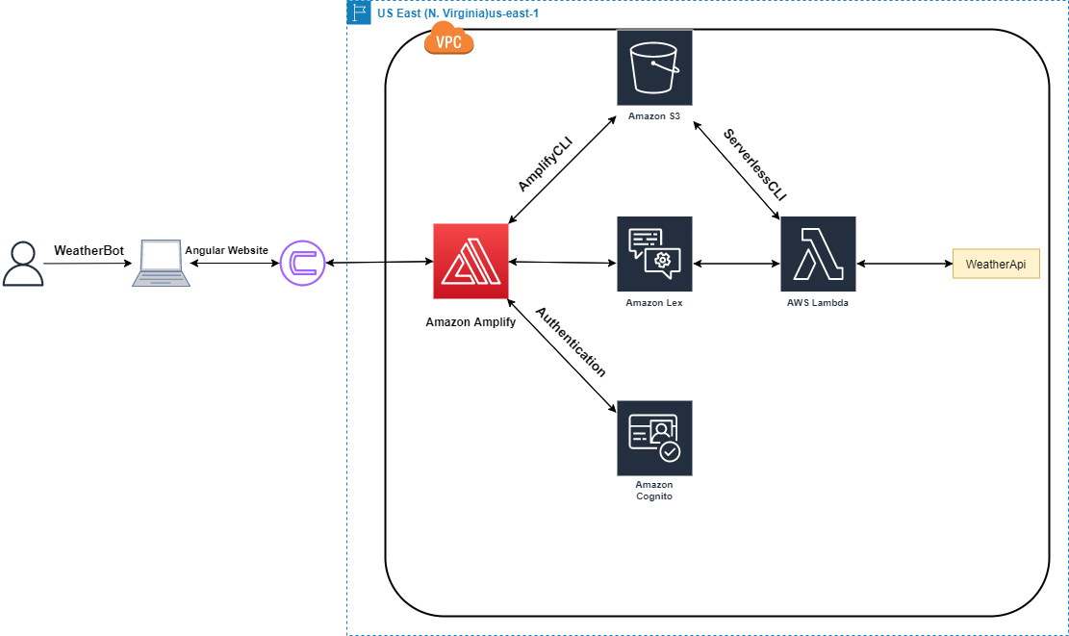
Architecture

Slide 5
Implementation

Slide 6
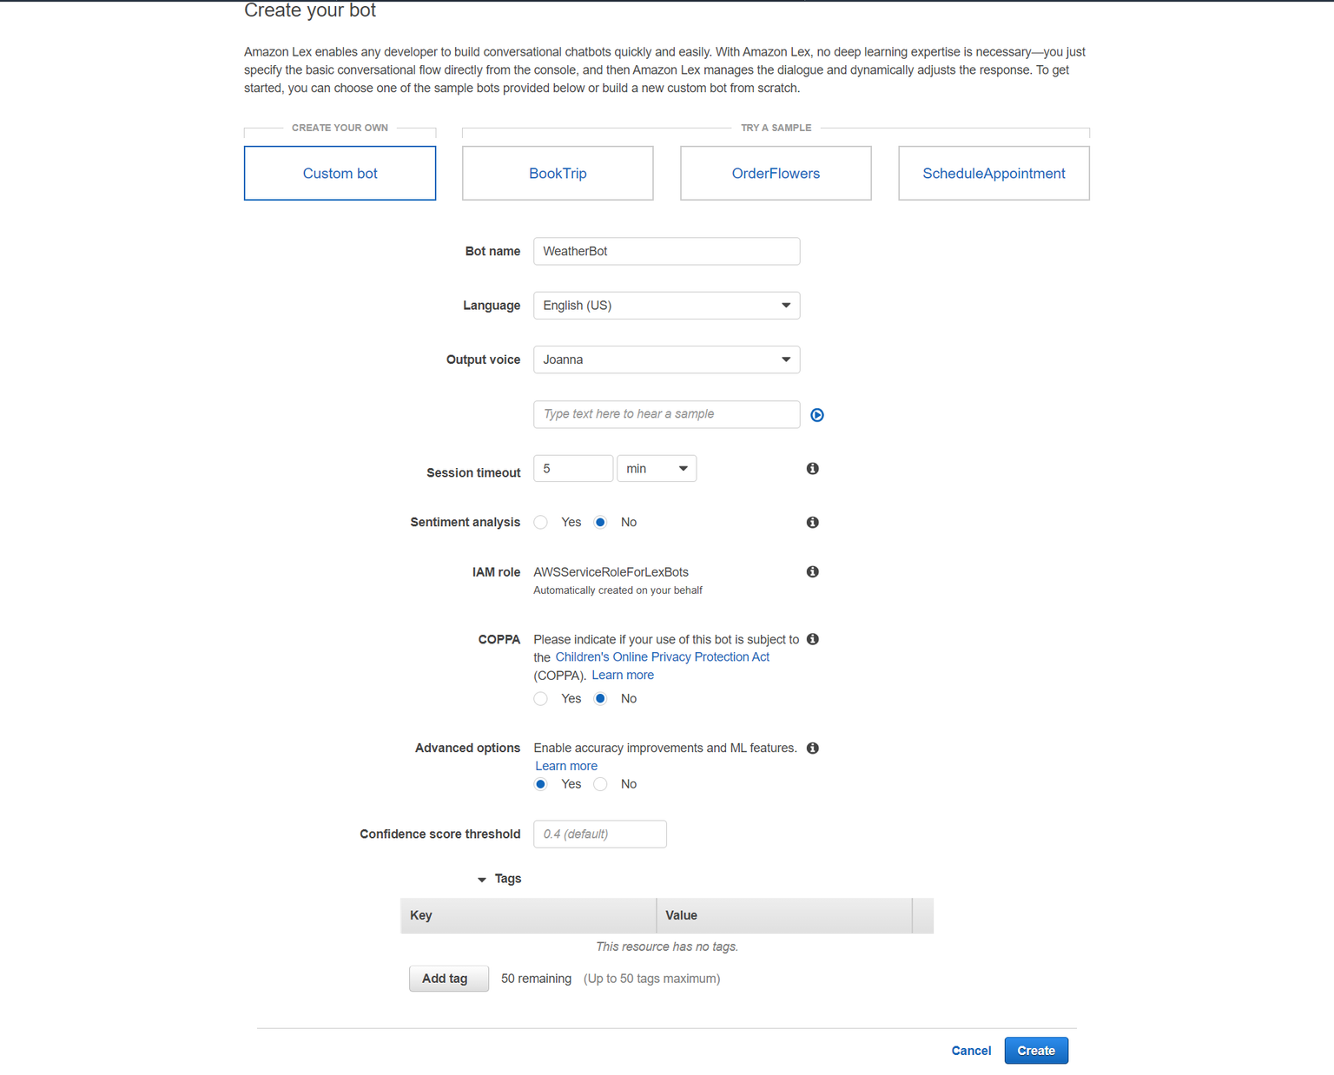

Slide 7
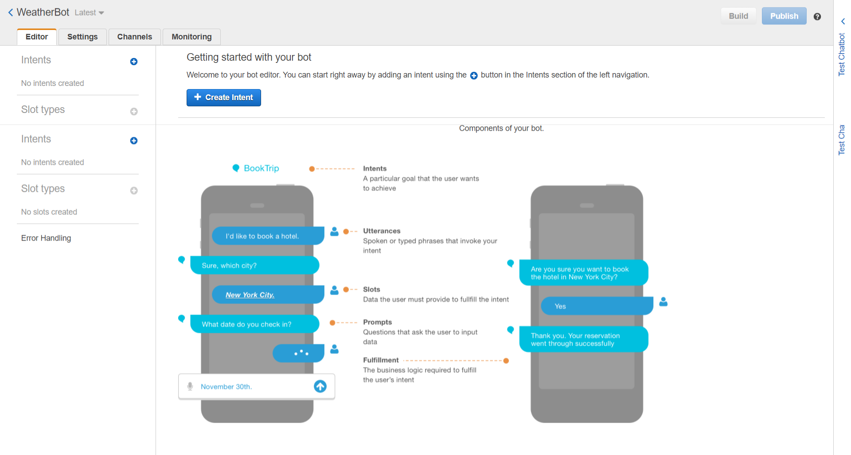

Slide 8
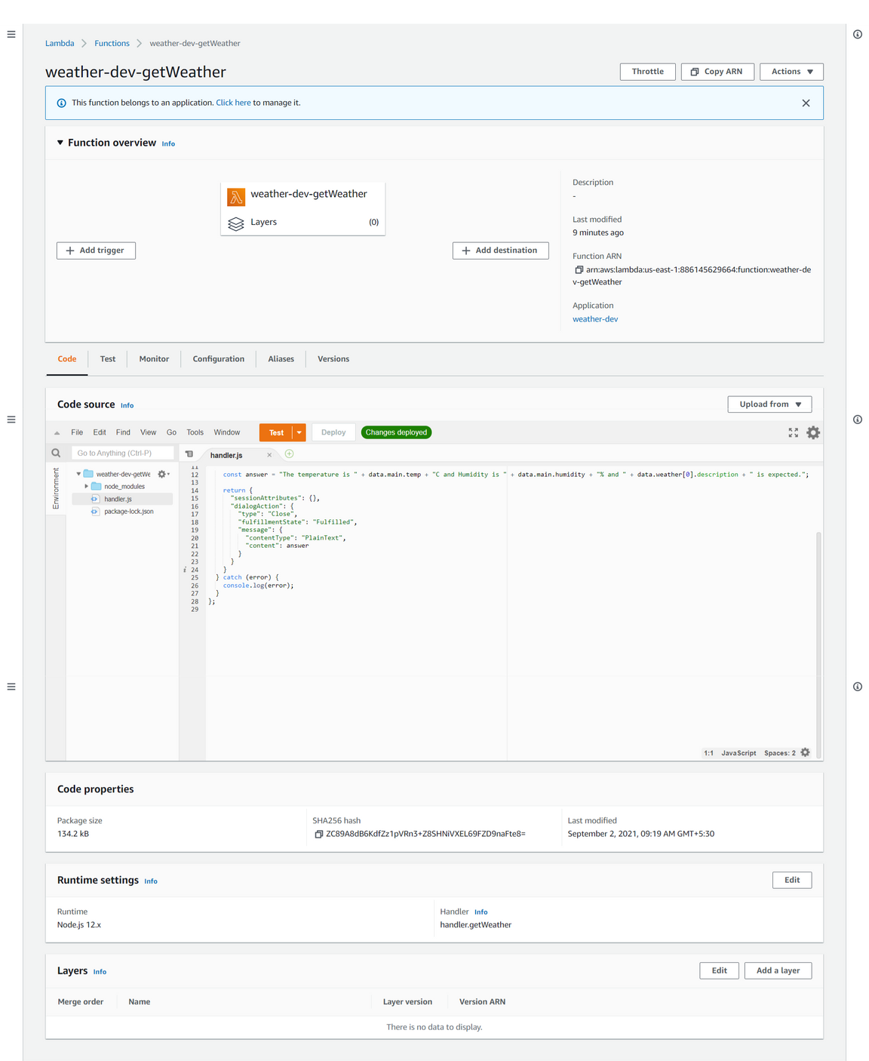

Slide 9
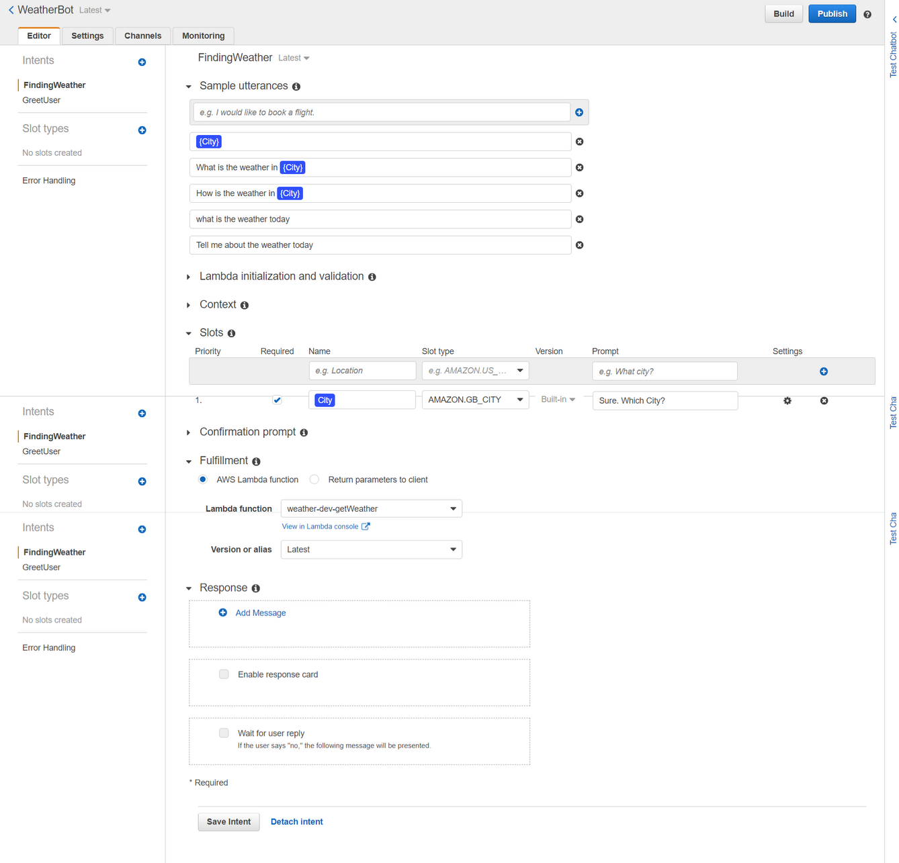

Slide 10
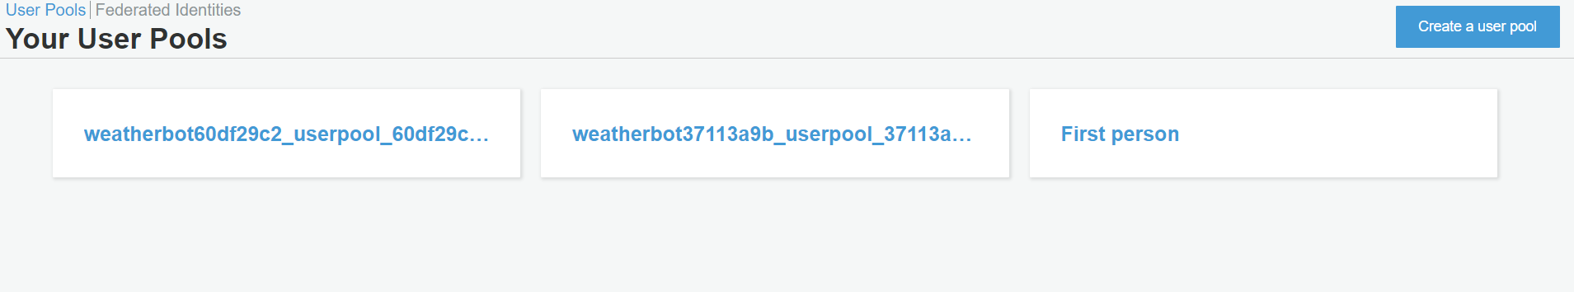

Slide 11
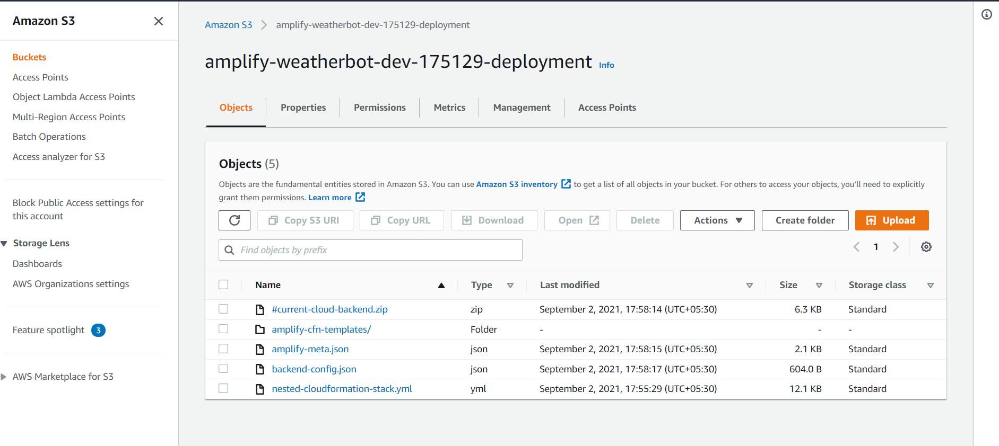

Slide 12
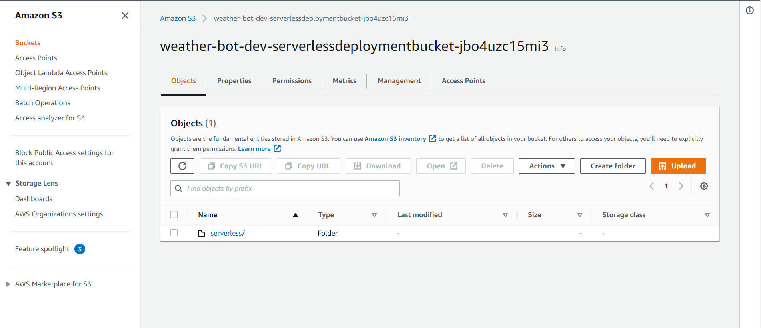

Slide 13
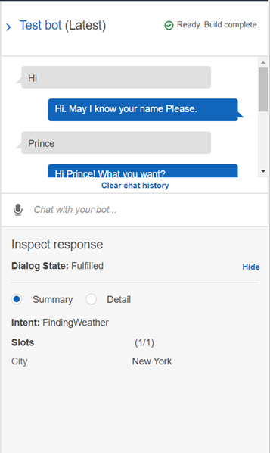
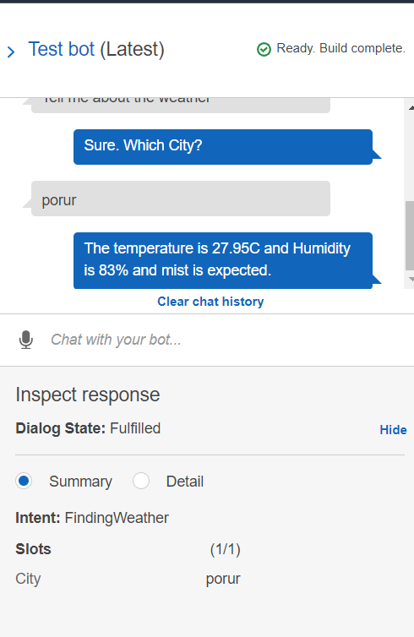

Slide 14
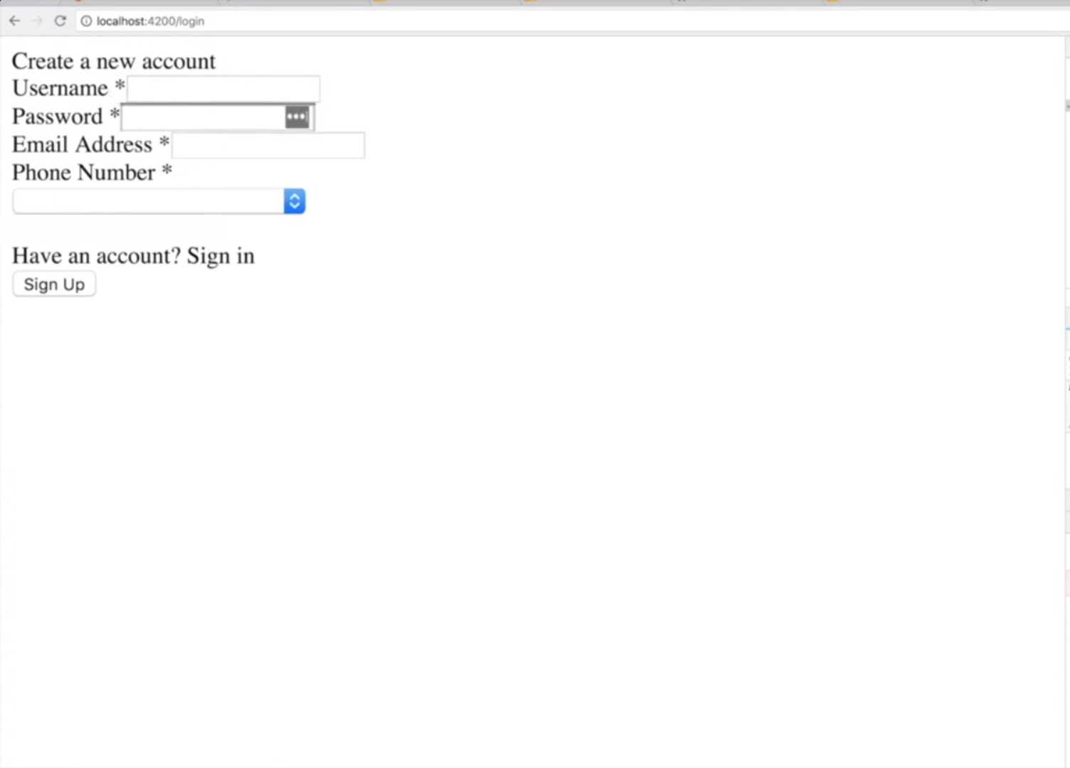

Slide 15
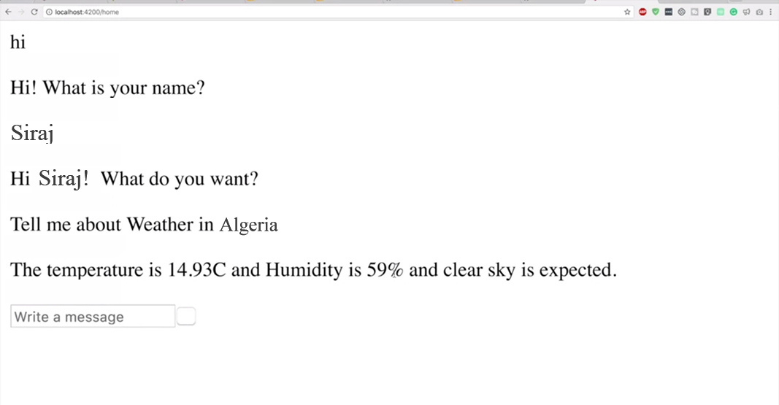

Slide 16
References
https://docs.aws.amazon.com/lexv2/latest/dg/getting-started.html
https://docs.aws.amazon.com/cognito/
https://docs.aws.amazon.com/lambda/latest/dg/getting-started-create-function.html
https://docs.amplify.aws/cli/
https://docs.aws.amazon.com/AmazonS3/latest/userguide/creating-bucket.html

